Slide 1

Github Copilot
Learning to love your eventual replacement

Slide 2
What is Copilot?
A Large Language Model similar to ChatGPT, that has been specifically trained on public code from Github.
It is owned by Github, which is owned by Microsoft, and was created by OpenAI.
First released June 21, 2021.
The main function of copilot is predictive code completion.

Slide 3
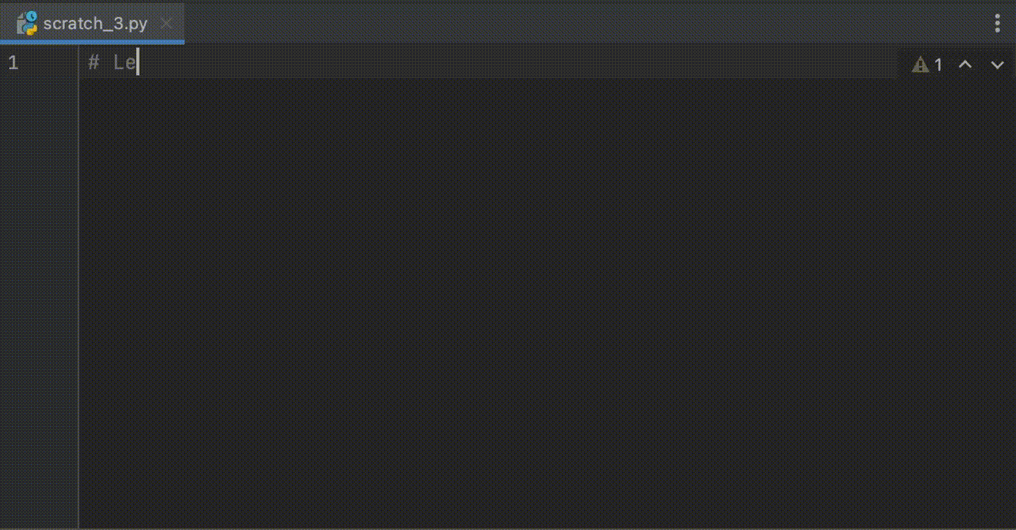
What does it do?
Predict code, given the context of the file you’re editing.

Slide 4
A confession: Peter was wrong
Peter once doubted the usefulness of Copilot.
Dialogue from February 2022:
Andrey: So have you heard about these new AI Pair programmers?
Peter: Yeah - but I have doubts. Programming is all about having a clear concept of what you’re doing. If you don’t have a clear concept, even the greatest AI can’t help you.
Andrey: But what about getting all the redundant lowlevel coding out of the way so you can focus on the concept?
Peter: But good code isn’t redundant! Good code should already be maximally compact. Only bad code is predictable.

Slide 5
Why Peter was wrong
…

Slide 6
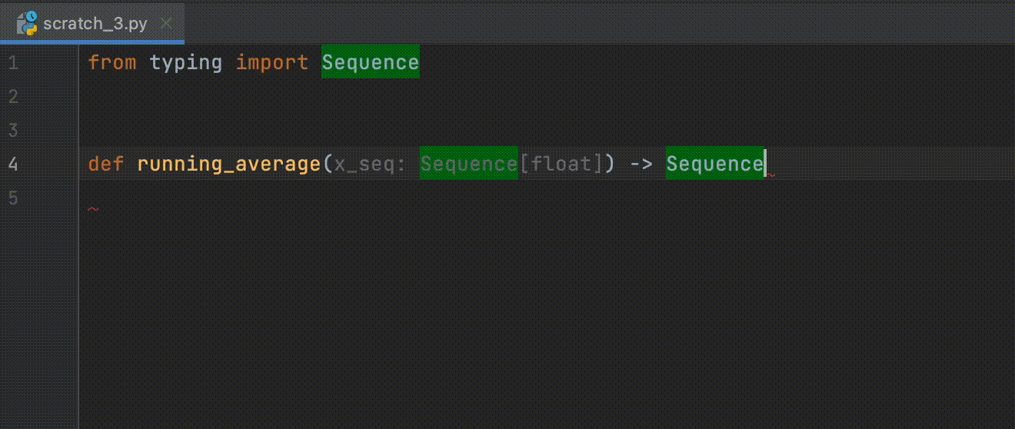
How can it be used?
Filling in a function body from a header:

Slide 7
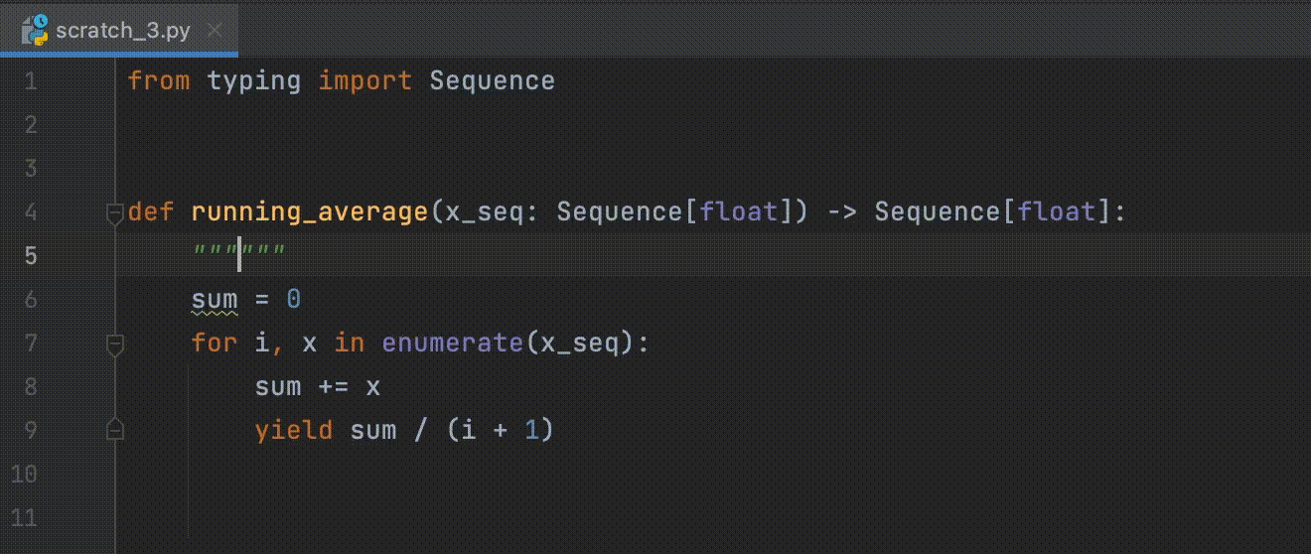
How can it be used?
Documenting a function

Slide 8
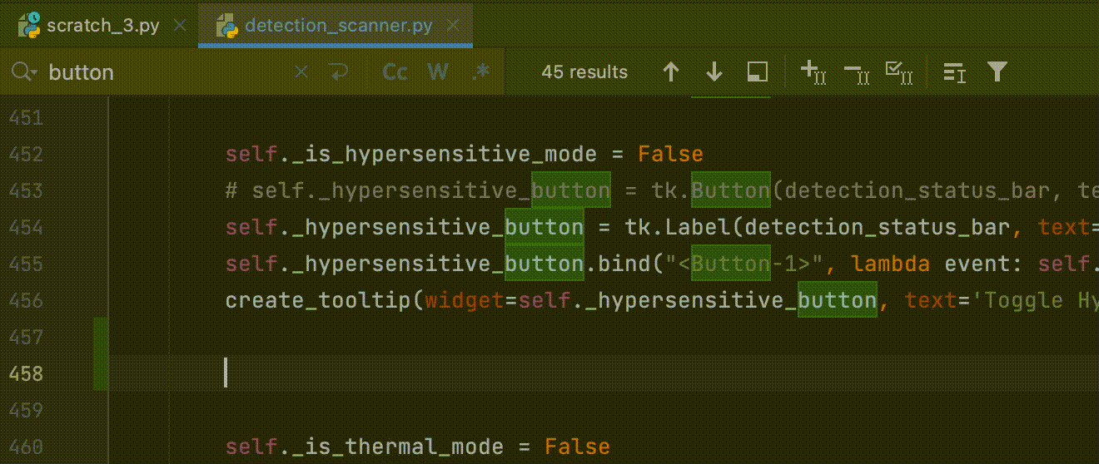
How can it be used?
Generating code from comments

Slide 9

Donations welcome e.g. $10 to support the space rental - POS machine works now!

